Slide 1
A Fast Algorithm for the Construction of Universal Footprinting Templates in DNA
James W. Anderson, Keith R. Fox, Graham A. Niblo
Journal of Mathematical Biology
Volume 52, Number 3, Pages 307-342, 2006
Presenter: Hsu-Shen Lin
Date: Mar. 24, 2006

Slide 2
Abstract
We introduce and give a complete description of a new graph to be used for DNA sequencing questions. This graph has the advantage over the classical de Bruijn graph that it fully accounts for the double stranded nature of DNA, rather than dealing with single strands. Technically, our graph may be thought of as the quotient of the de Bruijn graph under the natural involution of sending a DNA strand to its complementary strand. However, this involution has fixed points, and this complicates the structure of the quotient graph which we have therefore modified herein.

Slide 3
Abstract (cont.)
As an application and motivating example, we give an efficient algorithm for constructing universal footprinting templates for n-mers. This problem may be formulated as the task of finding a shortest possible segment of DNA which contains every possible sequence of base pairs of some fixed length n. Previous work by Kwan et al has attacked this problem from a numerical point of view and generated minimal length universal footprinting templates for n = 2, 3, 5, 7, together with unsubstantiated candidates for the case n = 4. We show that their candidates for n = 4 are indeed minimal length universal footprinting templates.

Slide 4
Introduction
A DNA segment containing all DNA segments of length n is known as a universal footprinting template (UFT) for n-mers. If the DNA segment is shortest possible among all universal footprinting templates for n-mers, we shall call it a minimal universal footprinting template for n-mers.
A
A
C
C
G
C
A
G
A
T
A
T
T
G
G
C
G
T
C
T
A
T

Slide 5
de Bruijn Graph
CTT
AAG
CTTG
TTG
CAA
CAAG

Slide 6
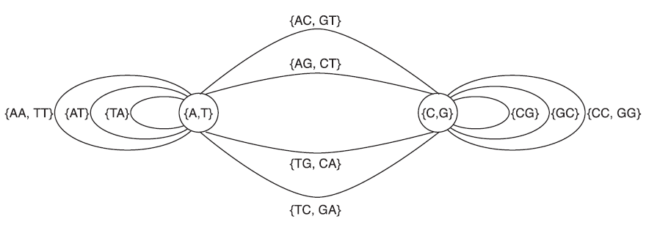
The 2-mer graph G₂

Slide 7
Problem
Finding an Eulerian path in the graph.
The classical de Bruijn graph has no vertices of odd degree.
aW
Wa
W
bW
Wb

Slide 8
Standard Loop
AAAA
TTTT
AAA
TTT

Slide 9
Lollipop Loop
TCGA
ATC
GAT
ATCG
CGAT
TCG
CGA
TTC
GAA
TTCG
TCGT
CGT
ACG
CGAA
ACGA
CTC
GAG
CTCG
TCGC
CGC
GCG
CGAG
GCGA
GTC
GAC
GTCG
TCGG
CGG
CCG
CGAC
CCGA

Slide 10
Lollipop Loop (cont.)
If n is odd, then G_{n} contains two standard loops and no lollipop loops.
If there is a lollipop loop incident to the vertex {V, V^{C}}, then {V, V^{C}} has the form {XUU^{C}, UU^{C}X^{C}} where X is a letter and U is a string of length m.
  If U=(X^{C} X)^{m/2}, then there are two lollipop loops incident to {V, V^{C}}, else there is one lollipop loop incident to {V, V^{C}}.

Slide 11
Path Construction
Construct a circular path joining the lollipop loops W=X₁…X_{P} X_{P}^{C}…X₁^{C} and W’= X_{P}^{C}…X₁^{C} X₁…X_{P} by cyclically permuting the letters.
W =X₁…X_{P} X_{P}^{C}…X₁^{C}
W₂=X₂…X_{P} X_{P}^{C}…X₁^{C} X₁
W₃=X₃…X_{P} X_{P}^{C}…X₁^{C} X₁ X₂
…
W’= X_{P}^{C}…X₁^{C} X₁…X_{P}

Slide 12
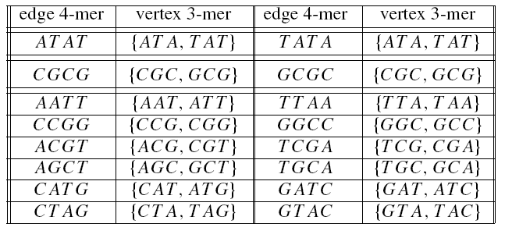
Path Construction (cont.)

